Slide 1
and Pedagogy
Dr. Kristin Haas
Jennifer Kolker
Dr. Aline Paris
Dr. Merryellen Towey Schulz
College of Saint Mary
Teaching Professor Technology Conference
October 3, 2015

Slide 2
What Pinterest says about itself….
"Pinterest is a tool for collecting and organizing things you love" (Pinterest.com).
At the bottom of the page they say, "Pinterest is a tool for collecting and organizing the things that inspire you."
Notes:
KH

Slide 3
Pinterest Statistics as of July 2015
72.8 million users
30 percent of all US social media users use
1 billion boards have been created
678,000 Google results for Pinterest & Pedagogy
50 billion pins created
Notes:
KH

Slide 4
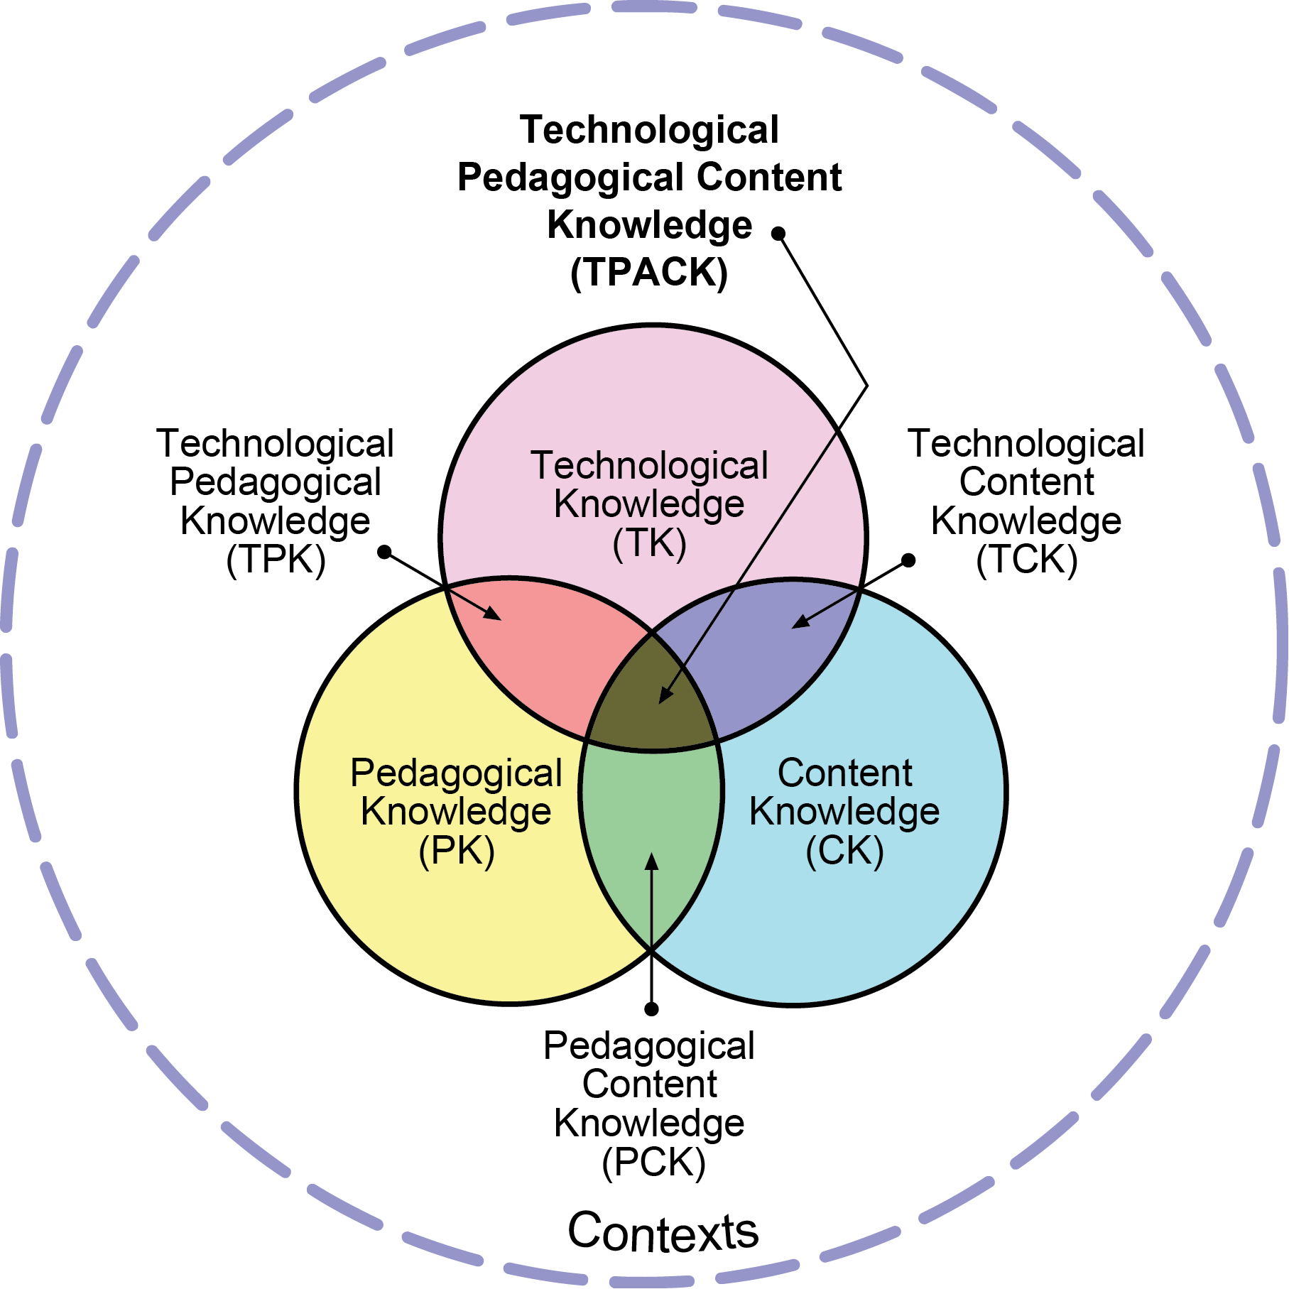
TPACK and
TPACK in 2 Minutes Video
Reproduced by permission of the publisher, © 2012 by tpack.org
Notes:
MTS

Slide 5
Authentic Integration of Technology
Write up to 500 wcharacters to comment on or describe a pin
Visual record of information and ideas
Social medium that allows users to share ideas and information
Place to collaborate on projects
Tools to make boards that are open to everyone
Tools to make boards open only
to invited members
Notes:
MTS

Slide 6
Big Personal
User of
Pinterest
Teacher
User
of Pinterest
Our Story
Never
heard of Pinterest
Young
Professor of Nursing
Professor of tttTheology
Professor of
Occupational tttttTherapy
Not So
Young
Tech Savvy
Tech Novice
Tech User
Professor of
Teacher
Education
Notes:
Sr. Aline

Slide 7
It all came together…
Never
heard of Pinterest
Big Personal
User of
Pinterest
Teacher
User
of Pinterest
Not So
Young
Professor of Nursing
Professor of ttttTheology
Young
Professor of
Occupational tttttTherapy
Tech Savvy
Tech Novice
Tech User
Professor of
Teacher
Education
Notes:
Sr. Aline

Slide 8
Pedagogy
Notes:
KH

Slide 9
Student Use
Collect Information
Brainstorming and Collaboration
Projects
Locate Images and Videos
Share Work
Notes:
KH

Slide 10
Instructor Use
Books and Book Lists
Collaboration
Lesson Plans and Ideas
Content
Learning Games
Art and Images
Notes:
KH

Slide 11
Our Projects
Paris
Towey Schulz
Haas
Kolker
Notes:
remember to show rubrics and assignment instructions- use the created website

Slide 12
Student Feedback
"I was really scared at first, because I had never used Pinterest, but it was so much fun."
"I never heard of Pinterest before this class, and now I am addicted."
Notes:
MTS

Slide 13
Benefits
Every student's Pinterest page was pleasing to look at, contained useful information and will be accessible for as long as each student wants it to be.
The ability of the students to share their work and to learn from each other increased the knowledge they gained from the course.
The pages will be living collections the students will be able to add to or revise continuously.
Notes:
MTS

Slide 14
Student Feedback on Pinterest Lesson
I think that using Pinterest for a class is a great way to integrate everyday social networks into learning experiences. Students get a chance to use something they are often glued to when they’re not in class. To me it is a step forward in education by thinking outside of the box and keeping up with our ever growing technology. Pinterest is a good site to use for projects so why not use it for school projects too, with todays society it is more common to see people working together and it is good to start this process of thinking while students are still in school.
Notes:
MTS

Slide 15
Benefits
Students discovered that many scholars and practitioners use Pinterest to generously share ideas and activities.
Early exposure to these resources will be valuable to them as they proceed through their academic programs and will serve them well as they enter professional practice.
Transparency of the student products
Unfortunately, in the past, there have been instances of plagiarism issues that arose with certain assignments. By publishing everyone's work for all to see, this problem was virtually eliminated.
The visual format of the Pinterest presentation of resources will promote use of a wider selection of resources as viewers can quickly become attracted by a picture than by just a written summaries of resources.
Notes:
MTS

Slide 16
Student Feedback on Pinterest Lesson
I still use my OTH 560 Pinterest board! All of my classmate's Pinterest boards have also helped me throughout level 2 fieldwork, studying for boards and practicing as an OT. Because it was a class assignment, I can trust that all information posted is evidence based and reliable.
Notes:
MTS

Slide 17
Your Turn
Go to Pinterest
www.pinterest.com
Login: teachingprofessor15@gmail.com
Password: technology
Search for your discipline
Notes:
JK

Slide 18
Working in Pinterest
Pin something from your discipline
Create a board for an assignment
Describe your assignment in the description
Pin something to your own board
Invite your neighbor to your board- complete the assignment!
1
2
3
4
5
Notes:
JK- other people helping with "students"

Slide 19
Evaluation
Instructions
Rubrics
Discussion
Reflection

Slide 20
Questions? Ideas? Anything to Share?

Slide 21
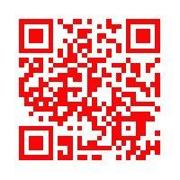
Resources
Tutorial
Use this QR Code to access
additional resources and our files.
Or go to
http://www.drmts.com/pinterest-pedagogy.html
Notes:
JK

